Slide 1
Deep learning
20b61a6622
k.Shivani
Cse(aiml)

Slide 2
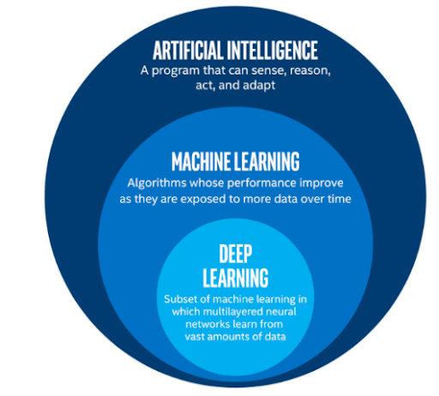

Slide 3
Deep learning is a subset of machine learning, which is essentially a neural network with three or more layers. These neural networks attempt to simulate the behavior of the human brain—albeit far from matching its ability—allowing it to “learn” from large amounts of data. While a neural network with a single layer can still make approximate predictions, additional hidden layers can help to optimize and refine for accuracy.
Deep learning drives many artificial intelligence (AI) applications and services that improve automation, performing analytical and physical tasks without human intervention. Deep learning technology lies behind everyday products and services (such as digital assistants, voice-enabled TV remotes, and credit card fraud detection) as well as emerging technologies (such as self-driving cars).

Slide 4
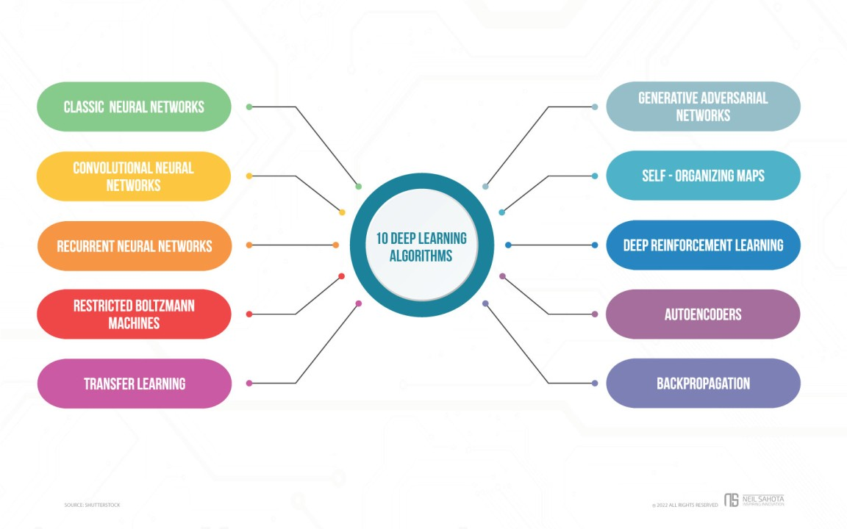
Fundamental Deep Learning Techniques

Slide 5
1. Classic Neural Networks Multilayer perceptrons, where the neurons are linked to the continuous network, are widely used to identify Fully Connected Neural Networks. Fran Rosenblatt, an American psychologist, created it in 1958. It entails the transformation of the model into basic binary data inputs. The following are the three functions incorporated in this model: Linear function: The term "linear function" refers to a single line that multiplies its inputs with a constant multiplier. Non-linear function: The non-linear function is further separated into three subsets: Sigmoid curve - The sigmoid curve is a function that has a range of 0 to 1 and is viewed as an S- shaped curve. Hyperbolic Tangent - The S-shaped curve with a range of -1 to 1 is known as the hyperbolic tangent (tanh). ReLU (Rectified Linear Unit): It's a single-point function that returns 0 if the input value is less than the specified value and the linear multiple if the input value is greater.

Slide 6
2. Convolutional Neural Networks The traditional artificial neural network model, CNN, is a sophisticated and high-potential variant. It's designed to handle increasing levels of complexity, preprocessing, and data compilation. It is based on the sequence in which neurons in the visual cortex of an animal's brain are arranged. CNN’s are one of the most versatile models for specializing in both image and non-image data. CNN’s are divided into four layers: It consists of a single input layer, which is typically a two-dimensional arrangement of neurons for interpreting primary visual data similar to picture pixels. A single-dimensional output layer of neurons in some CNNs processes images on their inputs via the distributed connected convolutional layers. A third layer, known as the sample layer, is present in CNNs to limit the number of neurons involved in the respective network levels.

Slide 7
3. Recurrent Neural Networks (RNNs) RNNs were initially developed to aid in the prediction of sequences; for example, the Long Short-Term Memory (LSTM) algorithm is well-known for its versatility. These networks are only based on data sequences with varied input lengths.
4. Boltzmann Machines This model has no predetermined direction. System monitoring, binary suggestion platforms, and particular dataset analysis all leverage this deep learning method. It is a one-of-a-kind deep learning approach for generating model parameters, with nodes organized in a circular pattern. It is distinct from the other deep learning network models and is also referred to as stochastic
5. Transfer Learning It is the process of fine-tuning a previously taught system or model to execute new and more precise jobs. This strategy is advantageous since it requires much less data than other ways and helps decrease long processing times.

Slide 8
Activation Function
Elements of a Neural Network
Input Layer: This layer accepts input features. It provides information from the outside world to the network, no computation is performed at this layer, nodes here just pass on the information(features) to the hidden layer.
Hidden Layer: Nodes of this layer are not exposed to the outer world, they are part of the abstraction provided by any neural network. The hidden layer performs all sorts of computation on the features entered through the input layer and transfers the result to the output layer.
Output Layer: This layer bring up the information learned by the network to the outer world.

Slide 9
The activation function decides whether a neuron should be activated or not by calculating the weighted sum and further adding bias to it. The purpose of the activation function is to introduce non-linearity into the output of a neuron.
Explanation: We know, the neural network has neurons that work in correspondence with weight, bias, and their respective activation function. In a neural network, we would update the weights and biases of the neurons on the basis of the error at the output. This process is known as back-propagation. Activation functions make the back-propagation possible since the gradients are supplied along with the error to update the weights and biases.

Slide 10
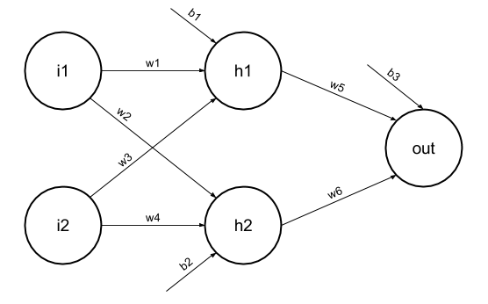

Slide 11
Hidden layer layer 1:
z(1) is the vectorized output of layer 1
W(1) be the vectorized weights assigned to neurons of hidden layer i.e. w1, w2, w3 and w4
X be the vectorized input features i.e. i1 and i2
b is the vectorized bias assigned to neurons in hidden layer i.e. b1 and b2
a(1) is the vectorized form of any linear function.

Slide 12
Layer 2 output layer
z(2) = W(2)a(1) + b(2)
a(2) = z(2)
Calculation at Output layer
z(2) = (W(2) * [W(1)X + b(1)]) + b(2)
z(2) = [W(2) * W(1)] * X + [W(2)*b(1) + b(2)]
Let,
[W(2) * W(1)] = W
[W(2)*b(1) + b(2)] = b
Final output : z(2) = W*X + b
which is again a linear function

Slide 13


